Slide 1
Investigation Task
Year 7 Science

Slide 2
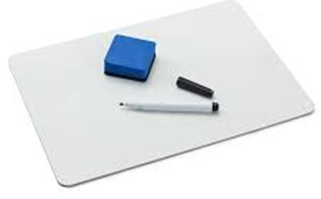
Review:
Draw a scientific diagram of a beaker.
When you light a Bunsen burner, should you light the match first or turn on the gas tap first?
Calculate the average (mean) for the following:
26 28 25 24 26

Slide 3
Learning Intentions
Collaboratively and individually plan and conduct a range of investigation types, including fieldwork and experiments, ensuring safety and ethical guidelines are followed

Slide 4
Success criteria
Finish your discussion
(if you haven’t already)

Slide 5
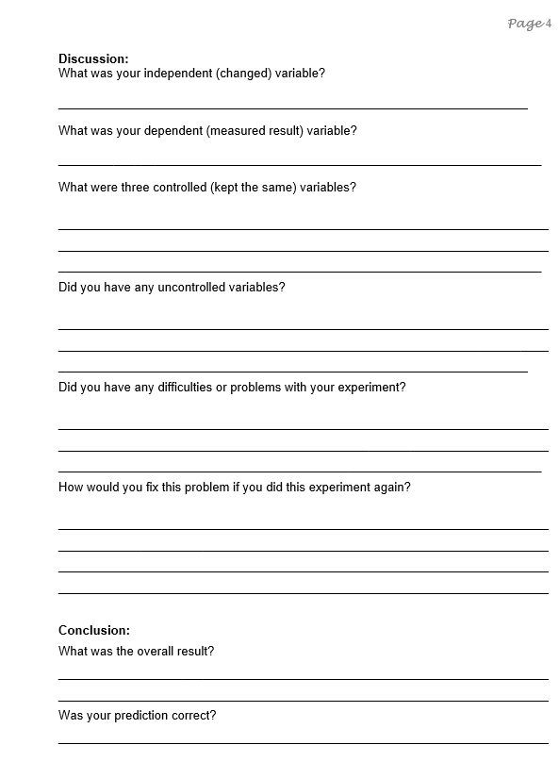

Slide 6
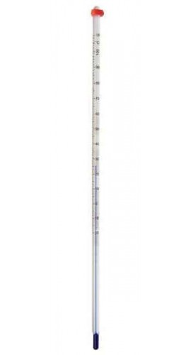
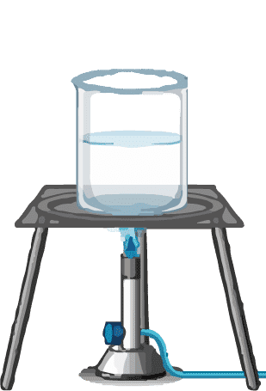
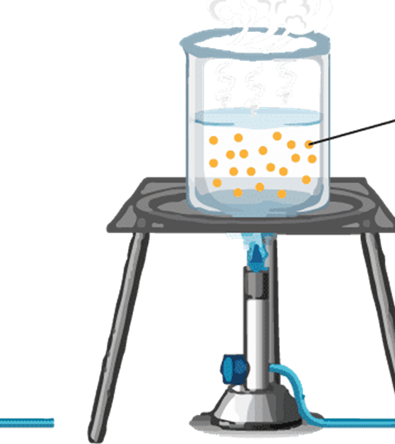
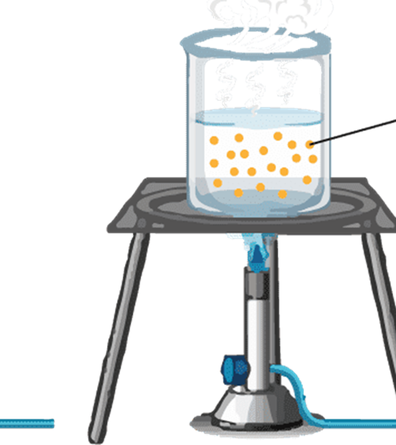
Salt and boiling point
1 tbs salt
2 tbs salt

Slide 7
Salt and boiling point

Slide 8
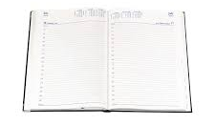
Next week
Investigating Test THURSDAY 29 Feb

Slide 9
Don’t forget
Homework sheet – Analysing graphs
Due Monday 26 Feb

